Slide 1

SIT Hackathon '24:
By:
Generative Solutions
-Soumedhik Bharati
-Sohoomlal Banerjee
-Archisman Ray
Theme: Application of AI in Education
Enhanced Automated Essay Grading with Explainability
Goal: Develop an AI model that grades essays and provides explanations for the score.

Slide 2

Explainable Essay Grading Model: A Holistic Approach
This presentation will explore the development of a comprehensive essay grading model, leveraging cutting-edge techniques such as bidirectional LSTM and Gemini for enhanced explainability. We'll delve into the key components, from feature engineering to model training, culminating in a robust system that provides detailed insights into the grading process.

Slide 3

Bidirectional LSTM Architecture
The foundation of our essay grading model is a bidirectional Long Short-Term Memory (BiLSTM) network. By processing the essay text in both forward and backward directions, the BiLSTM captures the nuanced contextual relationships within the written work, enabling a more holistic understanding of the content.

Slide 4
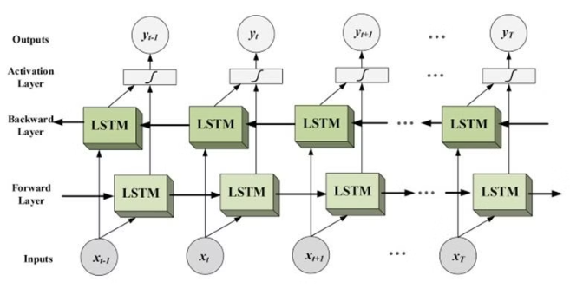
Architecture:
Bidirectional Long Short-Term Memory (Bi-LSTM) is a type of recurrent neural network architecture that consists of two LSTM layers, each processing input sequences in opposite directions. This bidirectional nature allows the model to capture both past and future context information, enabling it to better understand temporal dependencies in sequential data. In this architecture, the input sequence is fed into two separate LSTM layers: one processes the sequence from the beginning to the end, while the other processes it in reverse order. The outputs of these two LSTM layers are then concatenated or combined in some way before being passed to subsequent layers. By leveraging information from both past and future contexts, Bi-LSTM effectively captures long-range dependencies and has been widely used in tasks such as natural language processing, speech recognition, and time series analysis. Its ability to model bidirectional context makes it a powerful tool for sequential data processing tasks.

Slide 5
Our Solution to the Problem:
The proposed solution addresses the challenge of subjective marking of essays by developing a machine learning model to automate the grading process. The problem with subjective marking lies in its inconsistency and subjectivity, which can lead to unfair evaluations and hinder students' self-improvement. This model aims to provide a standardized and objective grading system that ensures fairness and enables students to receive constructive feedback for their essays.
The scope of the project includes implementing Long Short-Term Memory (LSTM) neural networks with Word2Vec embeddings to predict essay scores based on content and language. The target audience comprises educators, students, and educational institutions seeking a reliable and efficient method for grading essays, promoting self-improvement, and enhancing the learning experience.

Slide 6
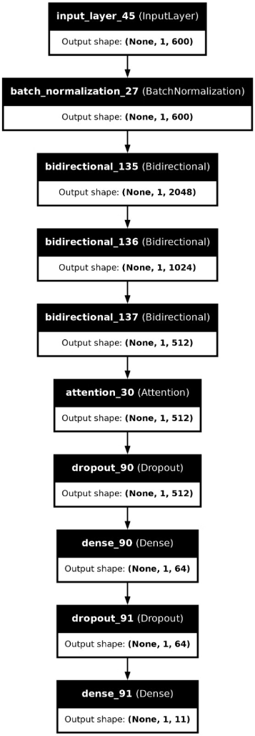
The LSTM model with attention mechanism, also known as LSTM Model 1, is designed to predict essay scores based on the content and language features. Here's how it works:
Input Layer: The model takes input of shape (1, 600), representing the Word2Vec embeddings of the essay.
Batch Normalization: Input data is normalized using BatchNormalization to improve convergence and speed up training.
LSTM Layers: Three Bidirectional LSTM layers are stacked on top of each other to capture temporal dependencies and extract features from the essay. Each LSTM layer has dropout and recurrent dropout to prevent overfitting.
Attention Mechanism: The attention layer takes the output of the third LSTM layer and computes attention weights. It focuses on relevant parts of the input sequence, allowing the model to give more weight to important words when making predictions.
Dropout Layers: Dropout layers with a higher dropout rate (0.6) are added after the attention layer and the first dense layer to further prevent overfitting.
Dense Layers: Two dense layers are added for classification. The first dense layer has 64 neurons and uses ReLU activation function. The second dense layer is the output layer with 11 neurons, representing the possible essay scores, and uses softmax activation function to output probabilities.
Compilation and Optimization: The model is compiled using the RMSprop optimizer with a learning rate of 0.001 and sparse categorical cross-entropy as the loss function.
The connections in the model are as follows:
The input layer receives the essay embeddings.
The BatchNormalization layer normalizes the input.
The LSTM layers process the input sequentially and extract features.
The attention mechanism computes attention weights.
The dropout layers prevent overfitting.
The dense layers perform classification based on the extracted features.
This model architecture aims to effectively capture the contextual information of the essay and make accurate predictions of its score.

Slide 7
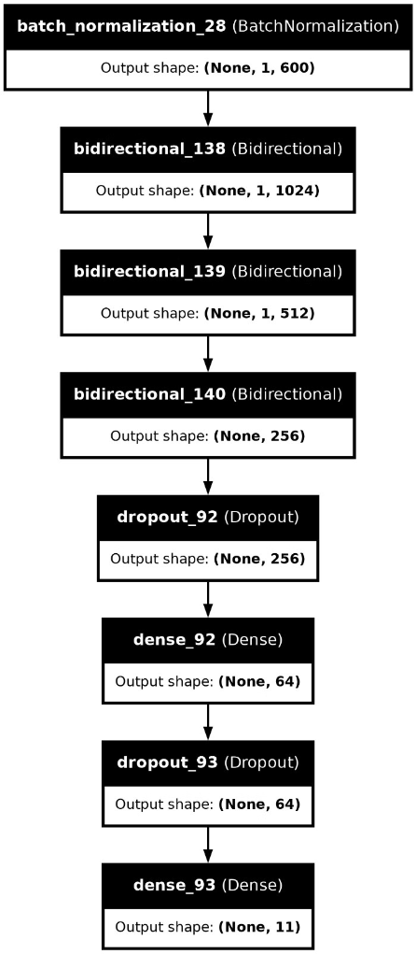
Model 2 is a sequential LSTM model with a similar goal of predicting essay scores. Here's how it works:
Input Layer: The model takes input of shape (1, 600), representing the Word2Vec embeddings of the essay.
Batch Normalization: Input data is normalized using BatchNormalization to improve convergence and speed up training.
LSTM Layers: Three Bidirectional LSTM layers are stacked on top of each other to capture temporal dependencies and extract features from the essay. Each LSTM layer has dropout and recurrent dropout to prevent overfitting.
Dropout Layers: Dropout layers with a dropout rate of 0.6 are added after the last LSTM layer and the first dense layer to further prevent overfitting.
Dense Layers: Two dense layers are added for classification. The first dense layer has 64 neurons and uses ReLU activation function. The second dense layer is the output layer with 11 neurons, representing the possible essay scores, and uses softmax activation function to output probabilities.
Compilation and Optimization: The model is compiled using the RMSprop optimizer with a learning rate of 0.001 and sparse categorical cross-entropy as the loss function. The connections in the model are as follows:
The input layer receives the essay embeddings.
The BatchNormalization layer normalizes the input.
The LSTM layers process the input sequentially and extract features.
The dropout layers prevent overfitting.
The dense layers perform classification based on the extracted features. This model architecture aims to effectively capture the contextual information of the essay and make accurate predictions of its score.

Slide 8
Gemini for Explainability
1
Interpretable Grading
2
Identifying Strengths and Weaknesses
3
Continuous Refinement
Gemini, a state-of-the-art explainability framework, is integrated into our model to provide detailed insights into the grading process. This helps instructors and students alike understand the rationale behind the assigned scores.
The Gemini-powered explainability further enables us to iteratively refine the model, incorporating feedback and insights to enhance the accuracy and reliability of the essay grading system.
Gemini's fine-grained analysis allows us to pinpoint the specific aspects of an essay that contribute to its overall score, empowering students to focus their improvement efforts effectively.

Slide 9



ReLU Activation Function
Nonlinearity
Efficient Training
Gradient Flow
The ReLU (Rectified Linear Unit) activation function introduces nonlinearity into our neural network, allowing it to model complex relationships within the essay text.
ReLU's simple and computationally efficient nature enables faster and more effective training of our essay grading model.
The ReLU function's properties also help maintain a stable gradient flow during backpropagation, improving the model's convergence and performance.

Slide 10
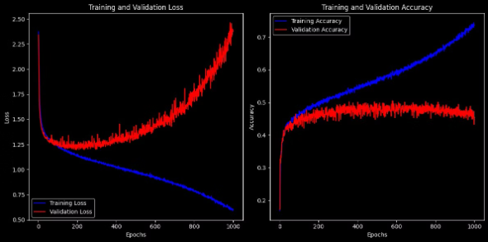
Why ensemble averaging?
Ensemble averaging is used in this project for several reasons:
Overfitting: By averaging the predictions of two LSTM models, we reduce the risk of overfitting. Each model may learn different patterns or noise in the training data. Averaging their predictions helps to smooth out these differences and produce a more robust final prediction.
Reduction of Bias: Ensemble averaging helps to reduce bias by incorporating multiple models. Each model may have its biases or shortcomings, and averaging their predictions can mitigate these biases, leading to more accurate results.
Lack of Proper Training Data: Sometimes, the training data may not be representative enough, leading to models that do not generalize well to unseen data. By averaging predictions from multiple models trained on different subsets or variations of the data, we can compensate for this limitation.
Improved Performance: Ensemble averaging often leads to better performance compared to individual models. It leverages the diversity of the models to achieve higher accuracy and reliability in predictions. In summary, ensemble averaging is used to address overfitting, reduce bias, compensate for the lack of proper training data, and ultimately improve the overall performance and robustness of the essay grading system.

Slide 11
Feature Engineering and Preprocessing
Word Embeddings
Batch Normalization
Regularization
We leverage pre-trained word embeddings to capture the semantic relationships between words in the essay text, providing a richer representation for the model to learn from.
Batch normalization is employed to improve the training stability and convergence of our neural network, ensuring robust and consistent performance.
To prevent overfitting, we implement various regularization techniques, such as dropout and L2 regularization, ensuring the model generalizes well to unseen data.

Slide 12
Model Training and Validation
Dataset Preparation
1
We carefully curate a diverse dataset of annotated essays, ensuring a robust and representative sample for model training and evaluation.
2
Model Architecture
Our essay grading model consists of two parallel BiLSTM networks, one with an attention mechanism and one without, to explore the impact of attention on the grading performance.
Ensemble Averaging
3
To further improve the model's reliability, we employ ensemble averaging, combining the outputs of the two BiLSTM models to produce the final essay grade.

Slide 13




Interpreting Essay Grades
Gemini Explainability
The Gemini framework provides a detailed breakdown of the factors contributing to the assigned essay grade, enabling instructors and students to understand the underlying rationale.
Highlighting Strengths
Gemini identifies the specific aspects of the essay that were executed well, allowing students to build on their strengths and continue improving.
Addressing Weaknesses
Similarly, Gemini pinpoints the areas where the essay could be strengthened, guiding students in their revision efforts and targeted skill development.

Slide 14

Demonstration:

Slide 15

Conclusion and Future Directions
Holistic Approach
Continuous Improvement
Our comprehensive essay grading model, leveraging BiLSTM architecture and Gemini explainability, provides a robust and insightful tool for evaluating written work.
By incorporating feedback and iterative refinements, we aim to further enhance the accuracy, reliability, and transparency of the essay grading system.
Expanding Capabilities
In the future, we plan to explore the integration of additional techniques, such as multimodal learning, to expand the model's capabilities and unlock new possibilities in essay assessment.

